Slide 1
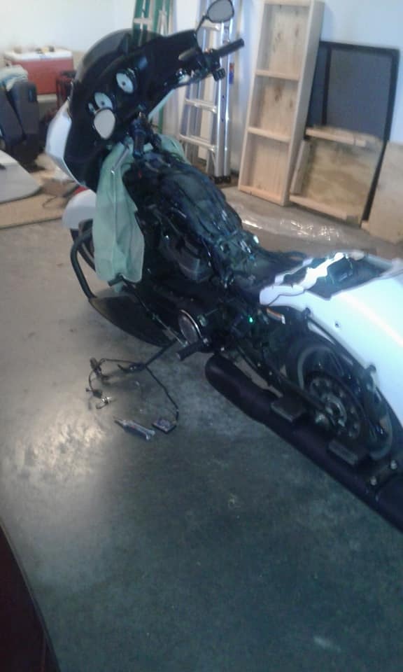
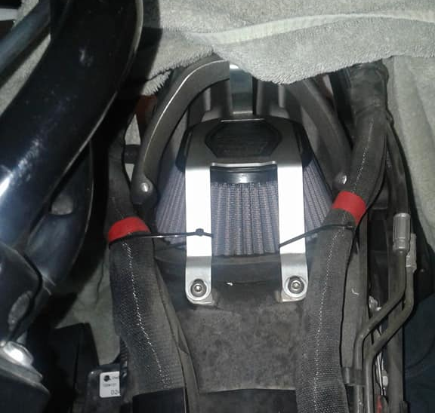
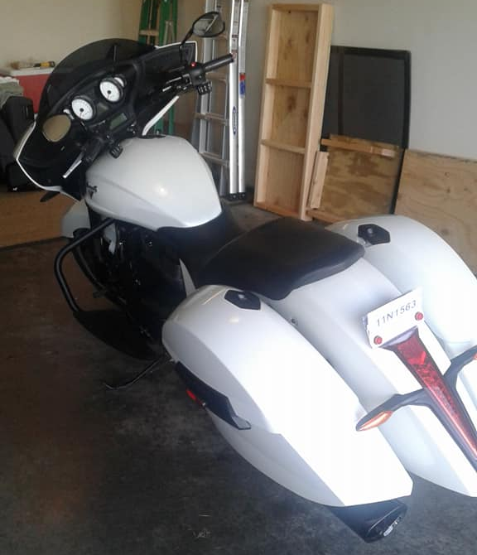
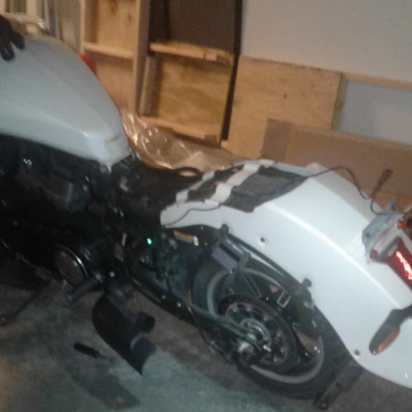
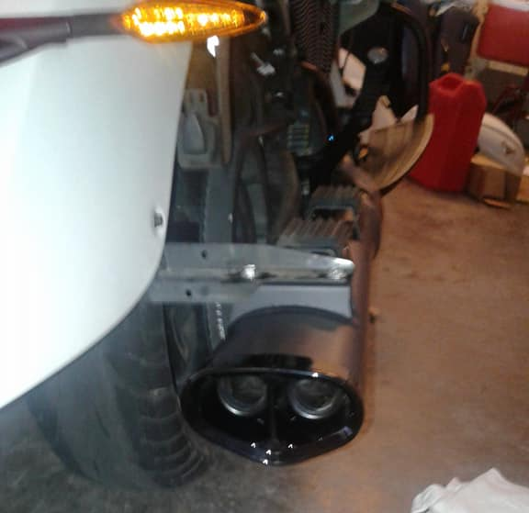
Stripped Down:
Power Commander Removed
Maximus Tuner Installed
Keyed Ignition Removed
Guard Dog – Remote Start Installed
New Lloyd’s Stage 1 Performance Filter Installed
New Stage 1 Tri-Ovals Installed
“Trash-Can” Exhaust Removed
Victory, Reassembled and Ready to Ride
(w/more to come)

